Slide 1
Social Media
Darcy Hanley

Slide 2
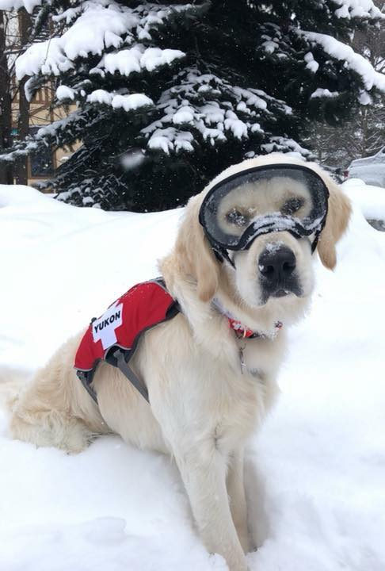
”LIKES”
Organic likes 1090
Followers 1107

Slide 3
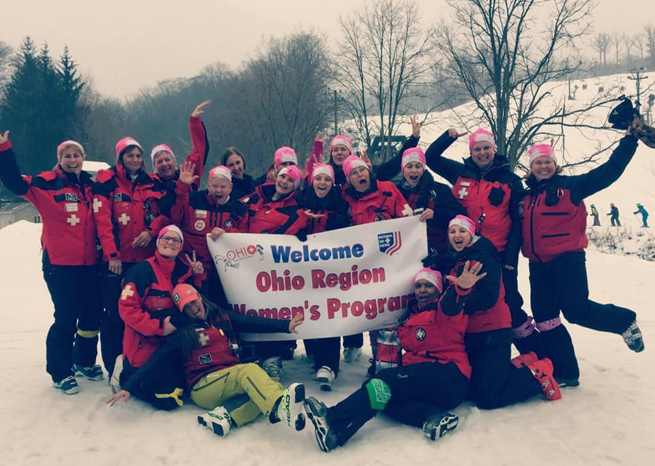
Support all NSP Programs

Slide 5
Promote sponsors, events, elections, accomplishments!

Slide 6
Tip of the Week Averages 430 views weekly!

Slide 7
https://www.facebook.com/skinsp/ See you at PEC!

