Slide 1
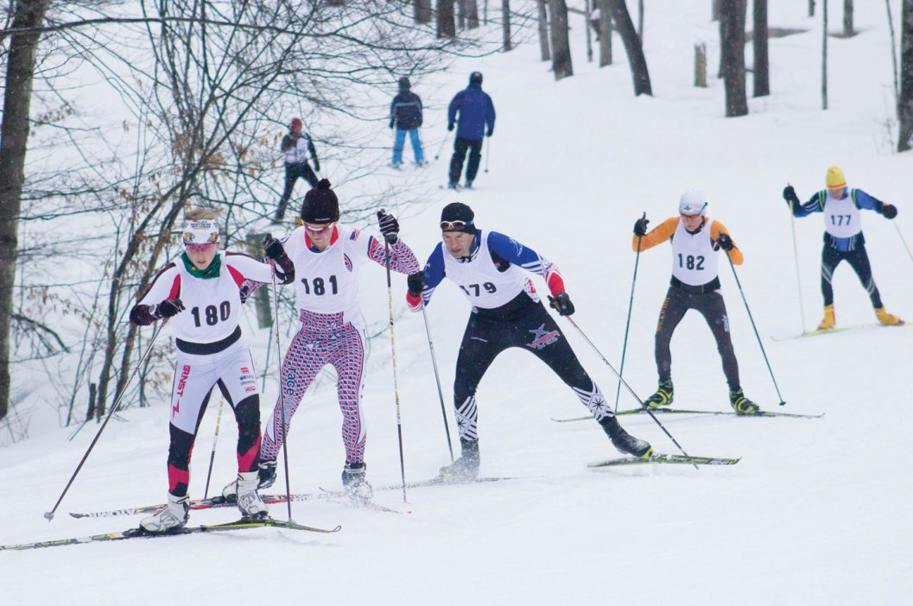
Central Division
2018-19 Election Plan

Slide 2
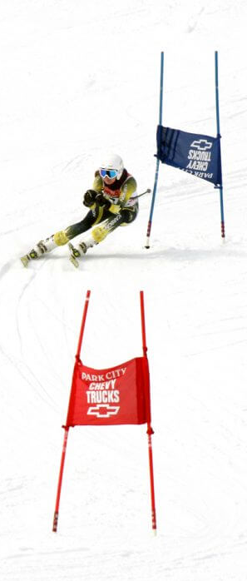
Agenda
Schedule
Elections
Electors
Election Committee

Slide 3
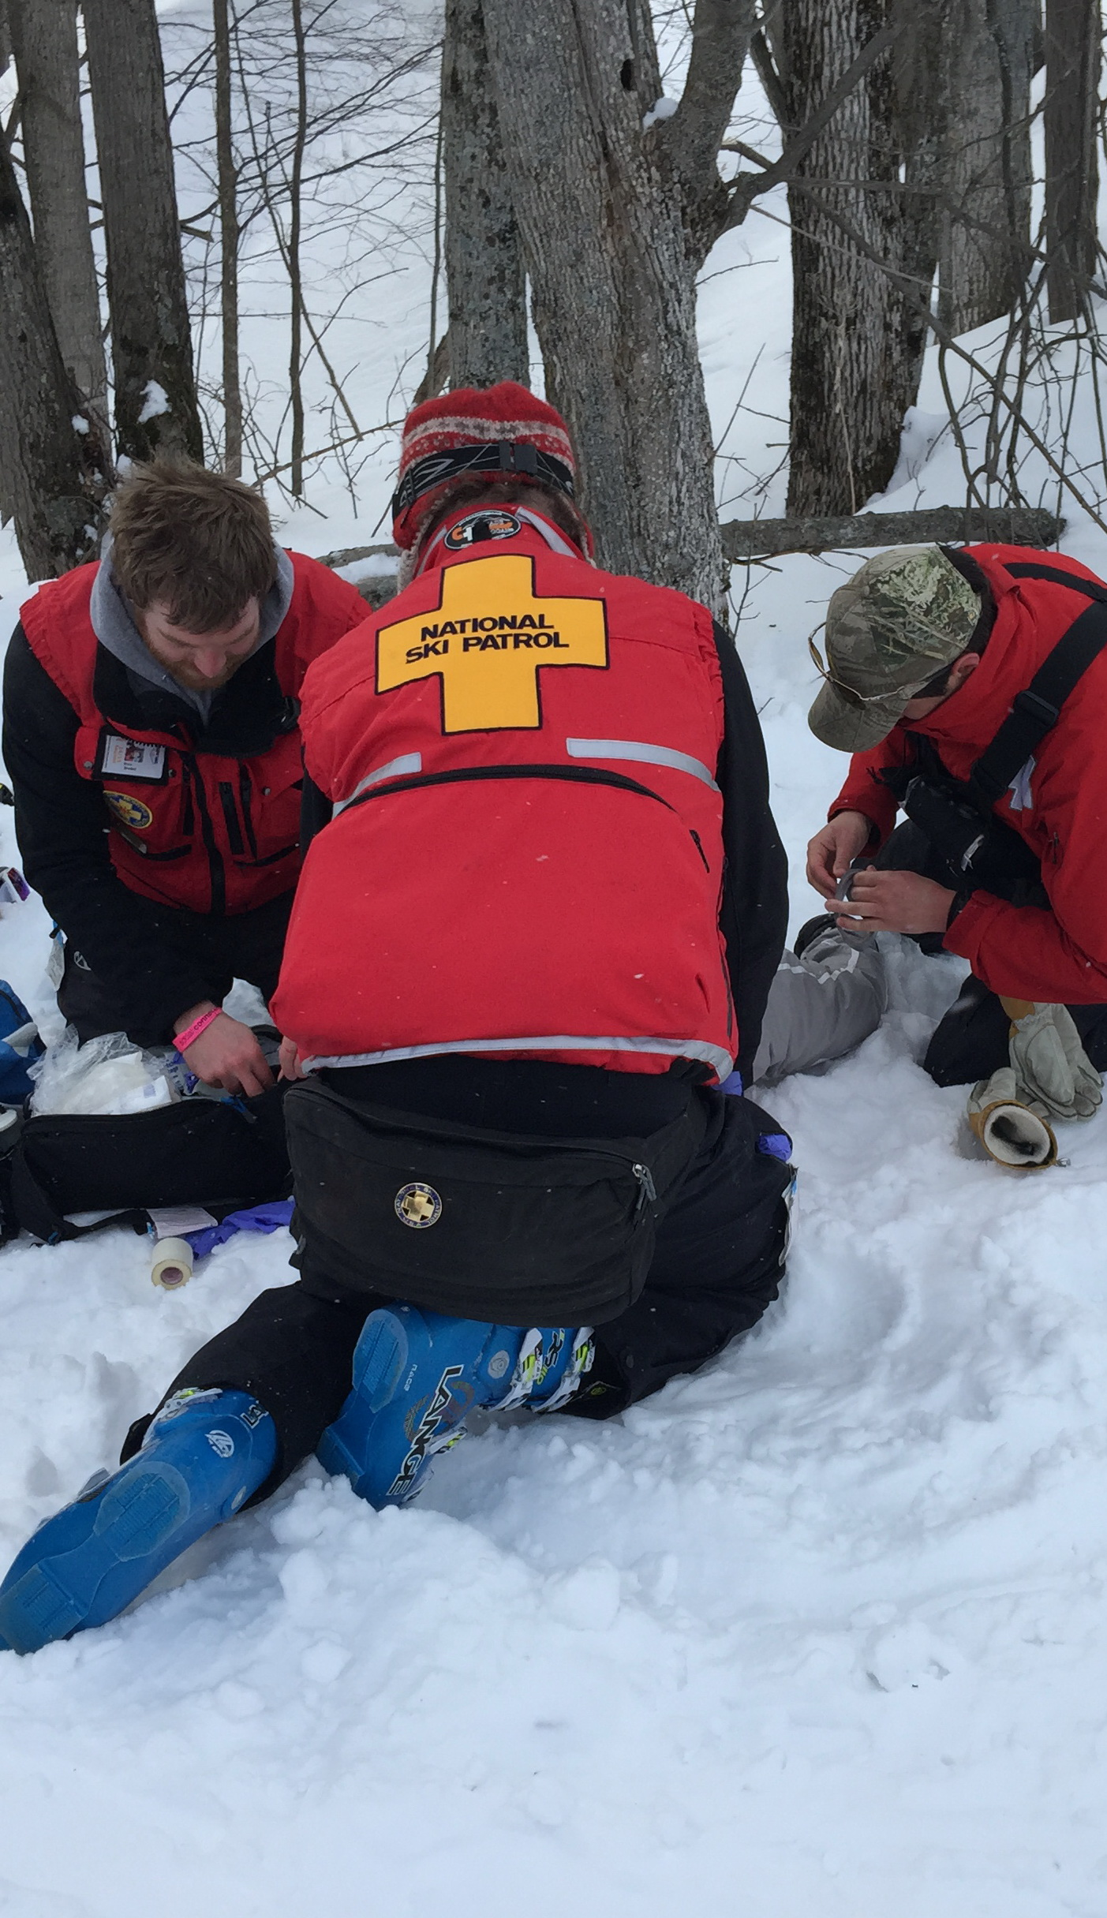
2018 – 19 Election Schedule
Sept: Send Election Announcement to RPN and WEB Master
Nov: Update Officer list
Dec: Request names of extra voters from large patrols
Jan 26, 2019 Nomination deadline
Feb 15, 2019 Voting Begins
March 8, 2019 Voting Ends

Slide 4
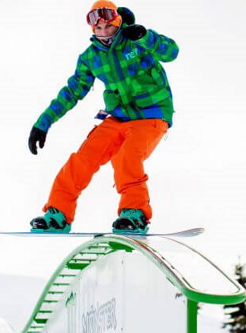
2018-2019 Elections
EMR
Mike Schons – End of 2nd term
SCR
Steve Paladini – End of 1st term
Division Director
John (JT) Thomas – End of 2nd term
Section 2 & 5

Slide 5
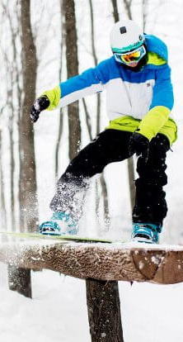
Electors
Each Patrol, Section Chief and RD gets one Vote
Patrols with over 50 members receive additional votes
2 – 50 members 1 vote
51 – 100 members 2 votes
101 – 150 members 3 votes
Over 151 members 4 votes
Note: WMR and SCR use 1 member 1 vote model for Region Director Elections.

Slide 6
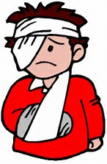
Region Director Elections
Required Qualifications:
Must be a registered NSP member for at least five years.
Must have served as a Section Chief, Patrol Representative, or National, Division, or Region Program Supervisor/Administrator for at least two years.
Must be familiar with National policies and procedures as defined in the current NSP Policies and Procedures manual.
Must be familiar with the Region's policies and procedures, as applicable.
Must be registered in the Division as a Senior (Alpine, Nordic or Auxiliary) Patroller or Certified Patroller.

Slide 7
Eastern Michigan Region Electorate
Alpine Valley East - Cecilia Gollan - 94 (+1)
Apple Mountain - Jon Banner - 22
Blizzard Metro - Mark Newton - 2
Clinton River Area Mountain Bike Association Bike Patrol 1 (No vote)
Independence Oaks Nordic - Jon O'Dell - 3
Mt Brighton - Lisa Niemi - 112 (+2)
Mt Holly - Tom Black - 113 (+2)
Pine Knob - Michael Rhadigan - 143 (+2)
Snowsnake Mountain - Richard Rausch - 40

Slide 8
Eastern Michigan Region Electorate cont…
Section 1 Chief – Jeffrey Jurcak
Section 2 Chief – Brad Carlson
Section 3 Chief – Roxanne Usewick
Region Director - Michael Schons (DD Only)

Slide 9
South Central Region Electorate
Region Director Election – 1015 Registered Patrollers as of 7/2018
Division Director Election – Patrol Directors
Alpine Valley West - Kathleen Ferrigan - 175 (+3)
Ausblick - Scott Robertson - 53 (+1)
Blackhawk Ski Club - Kenneth Matusek - 22
Blue Mound Nordic - Thomas Wright - 5
Skyline Area – 1 (No Vote)
Cascade Mountain - Lynn Thornton - 122 (+2)
Christmas Mountain - Adam Seymer – 1 (No Vote)
Notes:
Once a patrol is established at a resort it gets its supervision from and becomes part of the resorts operating structure.

Slide 10
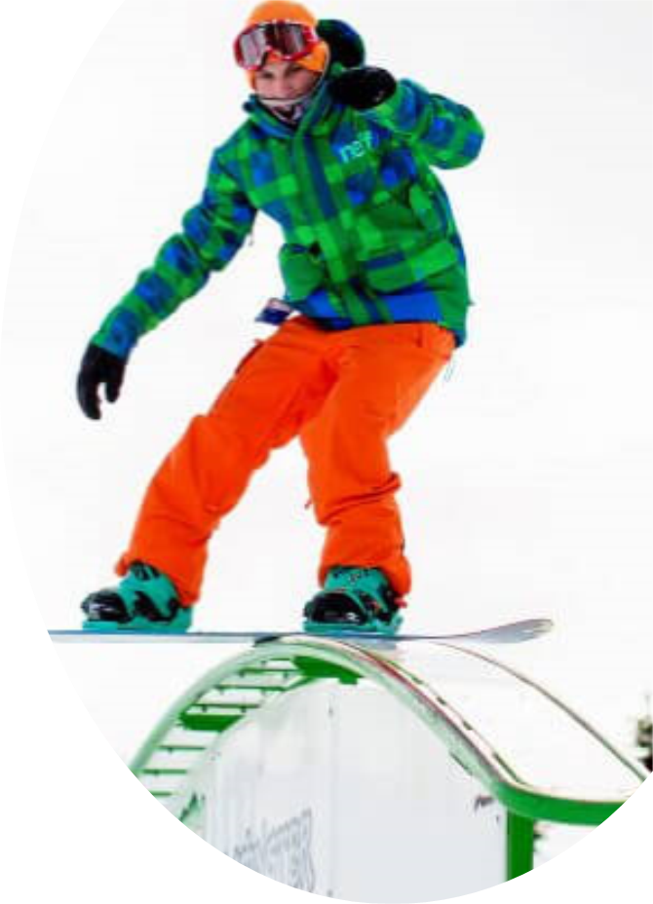
South Central Region cont….
Patrol Directors cont…
Devils Head - Jim Hubing - 126 (+2)
Fort McCoy - Mary Hirsch-Justice - 12
Fox Hill - Thomas Weinand - 9
Heiliger Huegel - Tom Williams - 50
Little Switzerland - Kevin Ketter - 93 (+1)
Mt La Crosse - Brent Johnston - 60 (+1)
Nordic Mt - Mike Buss - 70 (+1)
Tyrol Basin Ski Patrol - Katrina Moser - 78 (+1)
Notes:
Once a patrol is established at a resort it gets its supervision from and becomes part of the resorts operating structure.

Slide 11
South Central Region cont….
Administrators
Section 1 Chief – Maureen Minor
Section 2 Chief – Pat Schmitt
Section 3 Chief – Brad Bailey
Section 4 Chief – Dominick DeRosa
Region Director - Steve Paladini
Notes:
Once a patrol is established at a resort it gets its supervision from and becomes part of the resorts operating structure.

Slide 12
Central Division DD
Required Qualifications:
Must be a registered NSP member for at least five years. Membership in an NSP registered Professional Division patrol shall constitute NSP membership.
Must have served one term as Region Representative or two terms as a Section Chief, or must have served as a Region, Division, or National Program Supervisor for at least two years.
Must be familiar with National policies and procedures as defined in the current NSP Policies and Procedures manual.
Must be familiar with the Division's policies and procedures, as applicable.
Must be registered in the Division as a Senior (Alpine, Nordic or Auxiliary) Patroller or Certified Patroller.

Slide 13
North Central Region Electorate
Patrol | Members | Votes
Big Powderhorn Mt | 27 | 1
Big Snow Ski Patrol | 65 | 2
Bruce Mound | 16 | 1
Camp 10 | 9 | 1
Gladstone Sports Park | 3 | 1
Granite Peak | 101 | 3
Hidden Valley SP | 2 | 1
Marquette Mountain | 61 | 2
Minocqua Winter Park | 4 | 1
Mont Ripley | 78 | 2
Mount Bohemia Ski Patrol | 16 | 1

Slide 14
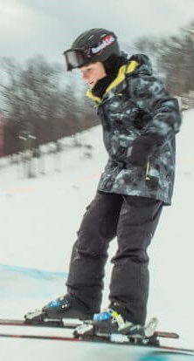
North Central Region Electorate cont….
Patrol | Members | Votes
Mt Ashwabay | 20 | 1
Navarino | 7 | 1
Nine Mile Forest | 4 | 1
Norway Mountain | 10 | 1
Pine Mountain | 39 | 1
Porcupine Mountain | 4 | 1
Ski Brule | 48 | 1
Standing Rocks | 2 | 1
Superior Nordic | 3 | 1

Slide 15
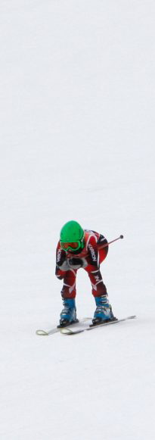
North Central Region Electorate cont….
Section 1 Chief – Jacob Grzesik
Section 2 Chief – Joseph Matuszak
Section 3 Chief – Bruce Iattoni
Region Director – James Hughes (DD Only)

Slide 16
Northern Michigan Region Electorate
Patrol | Members | Votes
Boyne Highlands | 104 | 3
Boyne Mountain | 52 | 2
Hanson Hills | 1 | 0
Hickory Hills | 16 | 1
Mt Holiday | 24 | 1
Nubs Nob | 86 | 2
Otsego Club Ski Patol | 27 | 1
Schuss Mountain | 38 | 1
Shanty Creek | 7 | 1
The Homestead | 10 | 1
Treetops Sylvan Resort | 23 | 1

Slide 17
Northern Michigan Region Electorate cont…
Section 1 Chief – Lisa Ballien
Section 2 Chief – Frederick Clark
Section 3 Chief – Dave Germond
Region Director - John Wiley (DD Only)

Slide 18
Ohio Region Electorate
Patrol | Members | Votes
Alpine Valley Ohio | 22 | 1
Boston Mills Brandywine Alpine Valley | 291 | 4
Cleveland Ski Club | 4 | 1
Cuyahoga Nordics | 3 | 1
Mad River Mountain | 113 | 3
Ohio Nordics | 2 | 1
Paoli Peaks | 61 | 2
Perfect North Slopes | 215 | 4
Snow Trails | 101 | 3

Slide 19
Ohio Region Electorate cont…
Section 1 Chief – Greg Schmidt
Section 2 Chief – Jim Burns
Section 3 Chief – Robert Wilson
Section 4 Chief – Ellen Mulqueeny
Region Director - Guy Day (DD Only)

Slide 20
Southern Region Electorate
Patrol | Members | Votes
Chestnut Mountain | 53 | 2
Des Plaines River Nordic | 4 | 1
Four Lakes | 67 | 2
Glacial Park | 5 | 1
Grand Geneva | 85 | 2
Hidden Valley Ski Patrol | 102 | 3
Michiana Bike Patrol | 2 | 1
Norsk | 3 | 1
Oak Ridge Patrol | 7 | 1

Slide 21
Southern Region Electorate cont…
Patrol | Members | Votes
Pines | 1 | 0
Raging Buffalo | 20 | 1
Seven Oaks | 47 | 1
Snow Creek | 86 | 2
Snowstar | 32 | 1
Sundown | 56 | 2
Swiss Valley | 49 | 1
Villa Olivia | 36 | 1
Wilmot Mountain | 172 | 4

Slide 22
Southern Region Electorate cont…
Section 1 Chief – Deb Allison
Section 2 Chief – Alfred Hurst
Section 3 Chief – Kathleen Schmidt
Section 4 Chief – Sue Smith
Section 5 Chief – Brian Parrish
Region Director – Mike Vaerewyck (DD Only)

Slide 23
Western Michigan Region Electorate
Patrol | Members | Votes
Bittersweet Patrol | 124 | 3
Caberfae | 59 | 2
Cannonsburg | 138 | 3
Crystal Mountain | 68 | 2
Timber Ridge | 76 | 2
West Michigan Nordic | 10 | 1

Slide 24
Western Michigan Region Electorate
Section 1 Chief – Martha Nowak
Section 2 Chief – Kevin Barrons
Section 3 Chief – Lourie Hurley
Region Director – John Donnelly (DD Only)

Slide 25
Western Region Electorate
Patrol | Members | Votes
Afton Alps | 167 | 4
Andes Tower Hill | 47 | 1
Buck Hill | 75 | 2
Buena Vista | 39 | 1
C163 - Mt Hardscrabble | 1 | 0
Christie Mountain | 49 | 1
Coffee Mill | 43 | 1
Detroit Mountain | 49 | 1
Giants Ridge | 60 | 2
Great Bear | 18 | 1
Hiawatha Nordic | 4 | 1
Lutsen Mt | 51 | 2

Slide 26
Western Region Electorate cont…
Patrol | Members | Votes
Mont Du Lac | 21 | 1
Mount Itasca | 5 | 1
Mount Ski Gull | 32 | 1
Mt Kato | 31 | 1
Powder Ridge Ski Patrol | 70 | 2
Spirit Mountain | 120 | 3
Three Rivers | 105 | 3
Trollhaugen | 75 | 2
Viking Nordic | 15 | 1
Welch Village | 108 | 3
Wild Mountain | 116 | 3

Slide 27
Western Region Electorate cont…
Section 1 Chief – Steve Willwerscheid
Section 2 Chief – Mike Nies
Section 3 Chief – Matthew Schmid
Section 4 Chief – Tom McConville
Section 5 Chief – Paul Botnen
Section 6 Chief – Tony Weber
Region Director – Scott O'Connor (DD Only)

Slide 28
Election Stats
 | Votes
Patrols | 180
Section Chiefs | 31
Region Directors | 8
Total Votes | 219

Slide 29
2019 Election Committee
North Central - James Hughes
North Michigan – John Wiley
Southern - Mike Vaerewyc

Slide 30
Proposals
Update Election Committee Schedule
Update Region Director Election Schedule
Update Division Director Election Schedule
On-line Elections

Slide 31
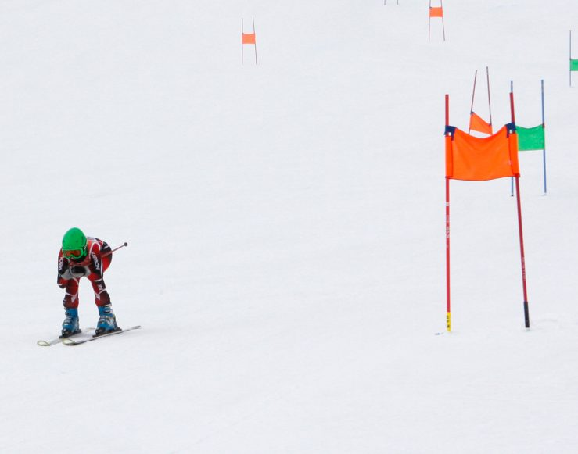
Questions?

Slide 35
