Slide 1

SAFETY TEAM PRESENTATION by: Mike Husar
NSP Safety Team Member
Sponsored By:
Central Division Fall Meeting
September 8th, 2012

Slide 2

Sponsored By:
Who is the Safety Team?
The 8 member Team Represents Six Divisions within the NSP
Mike Husar Sunburst Ski Area Central Division
Shauna Bocksch Copper Mountain Rocky Mountain Division
Patrick Cruver Stevens Pass Pacific Northwest Division
Brett Henyon Wintergreen Southern Division
Sal Mascareñas Grand Targhee Intermountain Division
Mark Petrozzi Gun Stock Mtn. Eastern Division
Ed Strapp Sugarloaf Maine Eastern Division
Lonny Whitcomb Ski Liberty Eastern Division

Slide 3
Sponsored By:
Team Vision Statement
NSP Safety Team will be the leader in mountain safety, education, awareness and hazards reduction.
Team Mission Statement
The National Ski Patrol Safety Team is to be the leaders of the ski industry in education, mountain safety for employee and guests. We will represent all members of the National Ski Patrol organization, its mission statement; with the highest level of patroller skills, commitment to creativity and integrity.

Slide 4


Sponsored By:
Current Safety Team Programs
Season Long Program
Recognizes Patrollers, Employees and Area Guests who demonstrate and follow safety procedures at your local area.
          January 19 to 27, 2013
          NSAA Safety Poster Contest
          Patrol Sweeps
          Patrol Room Tours
          Ambulance or Flight for Life Tours
          Safety Presentations
          Prizes for Demonstrating Safety on the Hill

Slide 5


Sponsored By:
Current Safety Team Programs
Kids on Lifts “Sit Back and Hold On”
This a joint effort between the NSAA and the NSP to promote safety for kids while riding a chair lift programs will include:
Posters, Trading Cards, Coloring Placemats, Etc..
Helmet Usage
We urge skiers and riders to wear a helmet – but to ski or ride as if they are not wearing a helmet. A skier’s behavior has as much or more to do with the safety of the sport as does any piece of equipment

Slide 6


Sponsored By:
Helmet Awareness
Stickers given out during safety talks

Slide 7
Sponsored By:
Current Safety Team Programs
Patroller Visibility Program
This program encourages patrollers to make contact with the area guests in a non emergency situation. Topics to be discussed could include
The Responsibility Code
Smart Style
Helmet usage
Proper Dress
Dangers of skiing closed runs

Slide 8
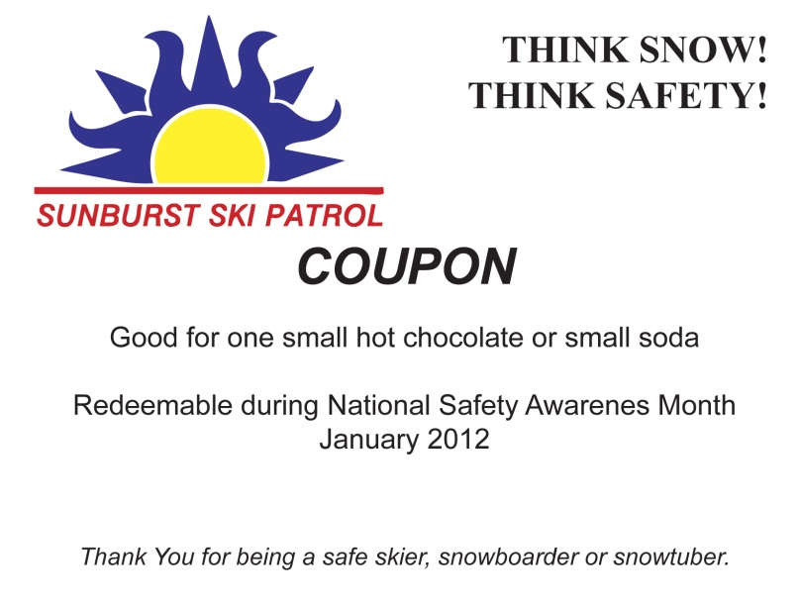
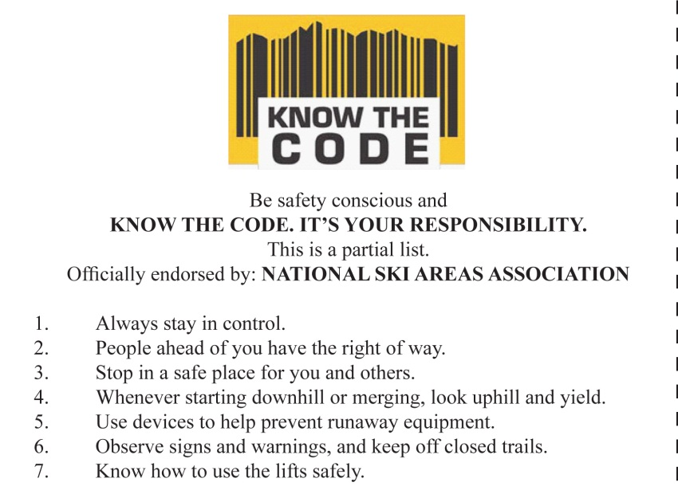
Sponsored By:
Patroller Contact Ideas
Front
Back

Slide 9
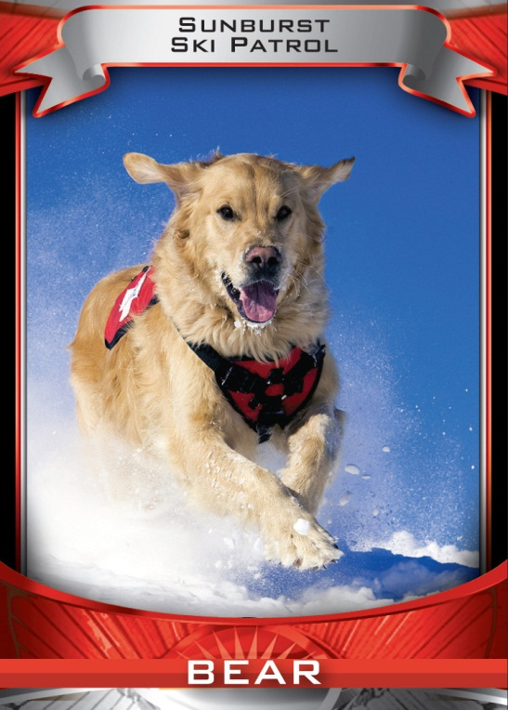
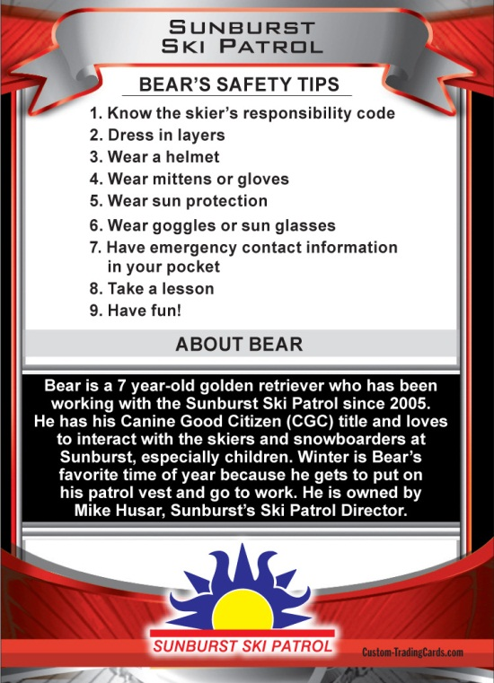
Sponsored By:
Patroller Contact Ideas
Front
Back

Slide 10
Sponsored By:
Current Safety Team Programs
Public Service announcements
The safety team has created 10 Public Service Announcement's that your patrol can give to local radio stations for broadcasting. Some of them can be tagged with your patrol or ski area name
Gear and Safety
Basic Backcountry Safety
Sun and UV Protection
Trail Markings
Terrain Parks
Side Country Safety
Gear Tune-Ups
Helmet Safety
Tree Well Safety
Your Responsibility Code
If you would like to use these PSA announcements contact Candice at the NSP office

Slide 11
Sponsored By:
My Goal for the Central Division
Get the NSP Safety message out to all patrols in the division by
    Emailing updates to Region Directors
    Articles in the Rusty Parka News
    Establish a Central Division Safety Team with each Region appointing a Safety Team member
    Communication with the Midwest Ski Area owners via the MSAA
    newsletter
    Annual Risk Management Seminars

Slide 12
Sponsored By:
Risk Management Seminar
Hosted By Sunburst Ski Area and Wells Fargo
November 4th, 2012
Topics to Include:
1. How patrols and area management can work together for the common good
      Hazard marking and who is in charge
      What constitutes a hazard?
      What are appropriate marking materials etc.
      Roll of Patrol and other ski area personnel
      Communication procedures
      Skier control and education
2. Finding risks and risk evaluation
      Are there certain areas that ski area management should be aware and addressing?
3. Accident investigation
      Post Incident Investigation
4. Kids on Lifts Program
      How ski areas and ski patrollers can work together to promote safety for kids on lifts.

Slide 13
Sponsored By:
Thank you for your time
Think safety
For more information contact
Mike Husar
262-629-4902
Mike@husars.com

